Slide 1

COST OF LIVING
ANALYSIS IN POWER-BI
PROJECT
Batch - MIP-DA-08.
Name:- Akash Shaw.
Position:- Data Analyst Internship.
Duration : 1 Month.
Starting Date : 5 May, 2024.
Location : Remote.

Slide 2

Overview
About Us
Data Source and Methodology
Objectives Project
Project Details
Gallery
Result and Analysis
Conclusion
Resource page
Wiki.

Slide 3

INTRODUCTION
The introduction to a cost of living analysis sets the stage for understanding the intricacies of expenses associated with residing in a particular area. It should provide context on the factors contributing to variations in the cost of living, such as housing, transportation, food, healthcare, and miscellaneous expenses. Additionally, it could touch upon the significance of comprehending these costs for individuals, businesses, policymakers, and researchers in making informed decisions regarding relocation, budgeting, investment, and policy formulation. This project focuses on visualizing cost of living data by using powerBI to uncover meaningful insights and trends.

Slide 4
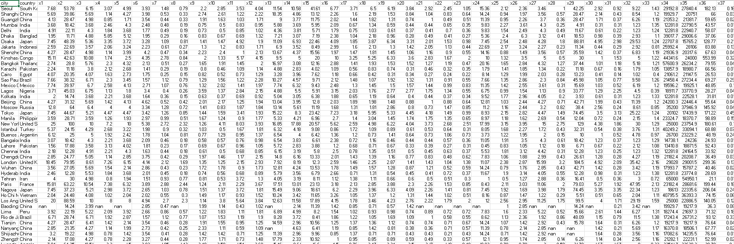
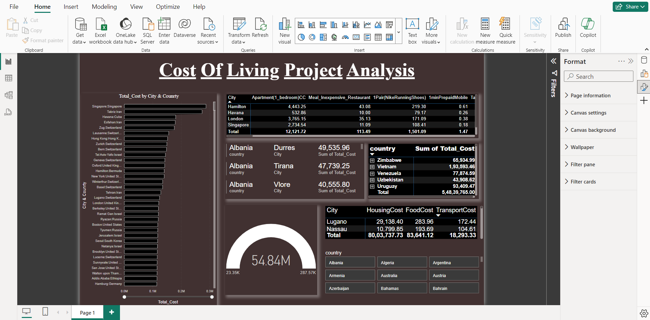
Data Source & Methodology
Data Source:
The dataset used in this project consists of cost of living data obtained from [Insert Source]. It includes information such as housing, transportation, food, healthcare, and miscellaneous expenses.
Methodology:
The analysis is performed using PowerBI visuals to extract, transform, and visualization the data. Various PowerBI functions and techniques are utilized to derive key metrics and perform statistical analysis.

Slide 5
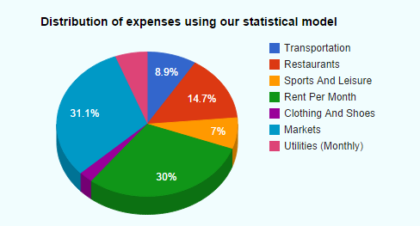
Objectives:
The objective of the Cost of Living dataset is to provide insights into the financial requirements for sustaining a certain lifestyle in different locations. It aims to help individuals, businesses, and policymakers make informed decisions regarding budgeting, relocation, compensation, and economic planning.

Slide 6

The Project:
The Cost Of Living Analysis by powerBI project aims to analyze cost living data from a Country cost living database using powerBI.
By achieving these objectives, a cost living analysis project aims to optimize cost operations, enhance living satisfaction, and ultimately drive life living success.

Slide 7

Project Details:
PowerBI Visuals Of Top 11 Cost Of Living Countries According To Given Dataset:-
Usa,
Switzerland,
Norway,
Iceland,
Japan,
Denmark,
Bahamas,
Luxembourg,
Israel,
Singapore,
South Korea.
Bottom 2 Cost of Living Countries:-
INDIA
PAKISTAN.

Slide 8
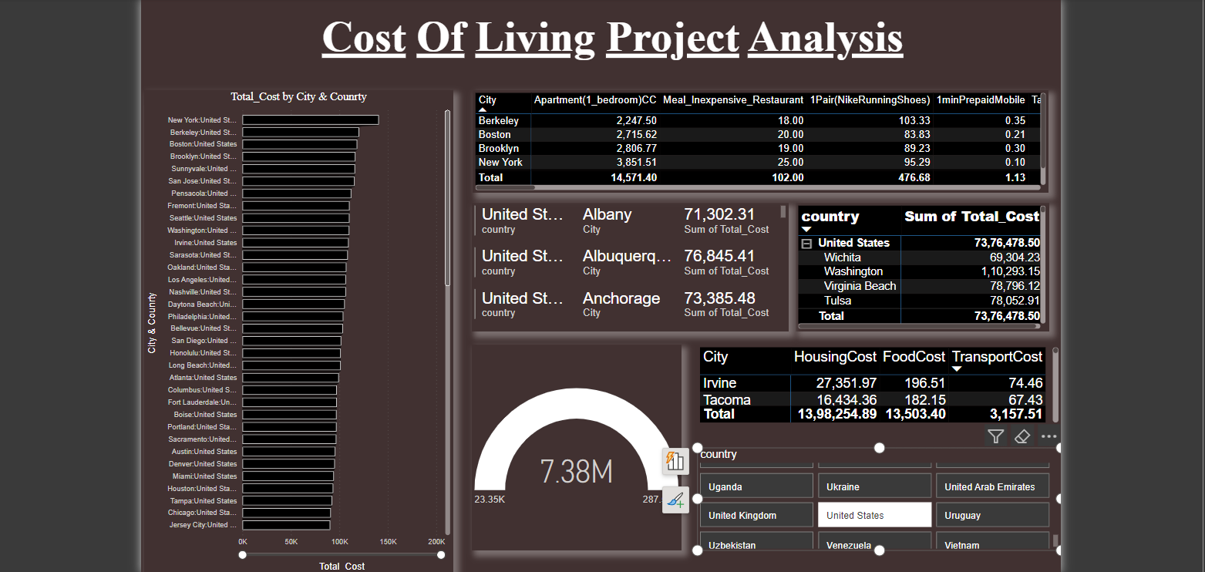
1. Cost Of Living In USA PowerBI Visualization.

Slide 9
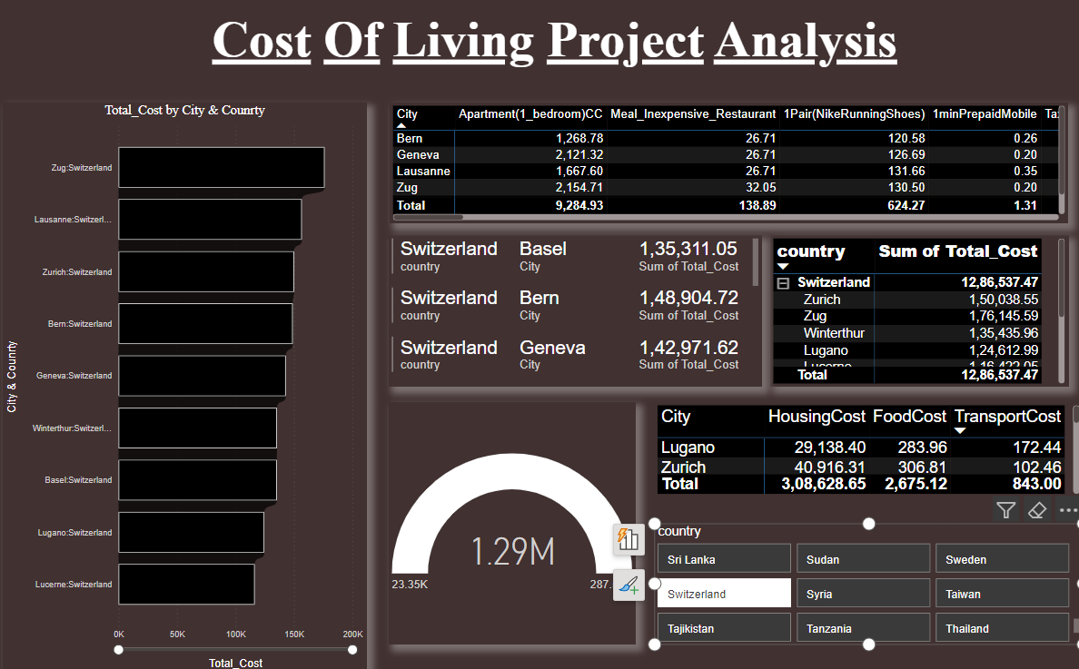
2. Cost Of Living In Switzerland PowerBI Visualization.

Slide 10
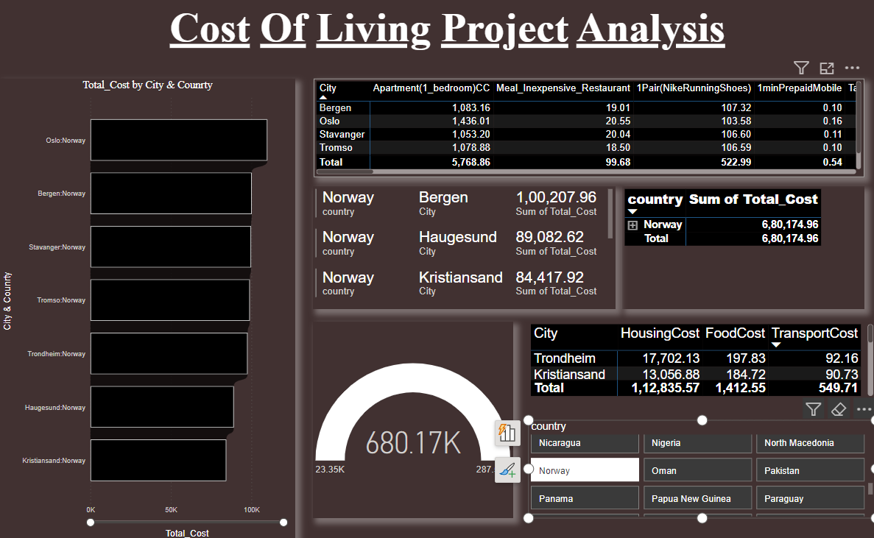
3. Cost Of Living In Norway PowerBI Visualization.

Slide 11
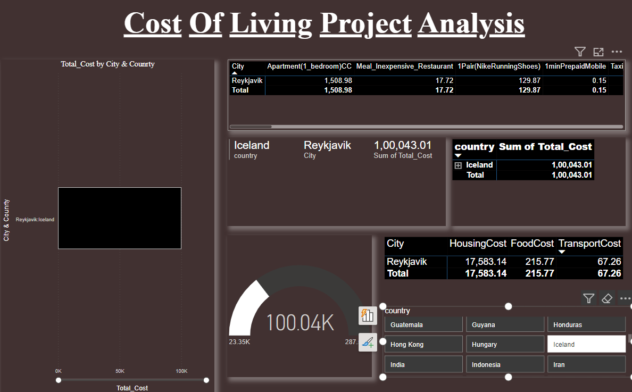
4. Cost Of Living In Iceland PowerBI Visualization

Slide 12
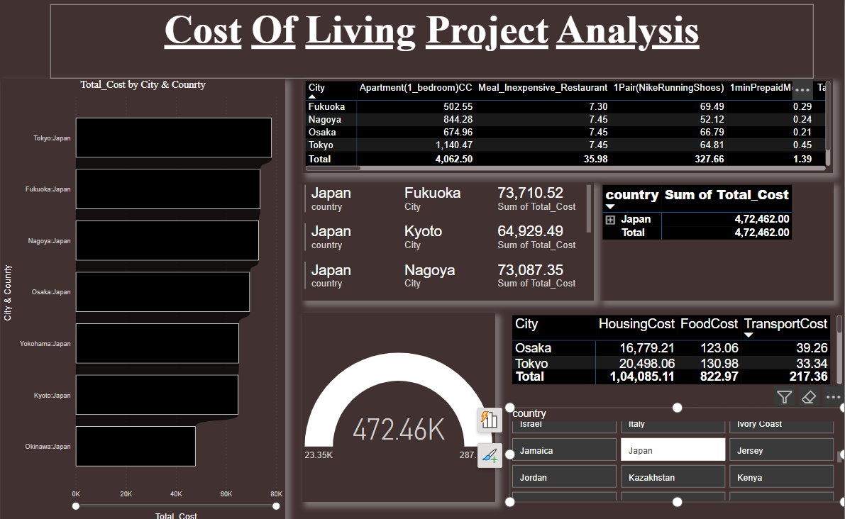
5. Cost Of Living In Japan PowerBI Visualization.

Slide 13
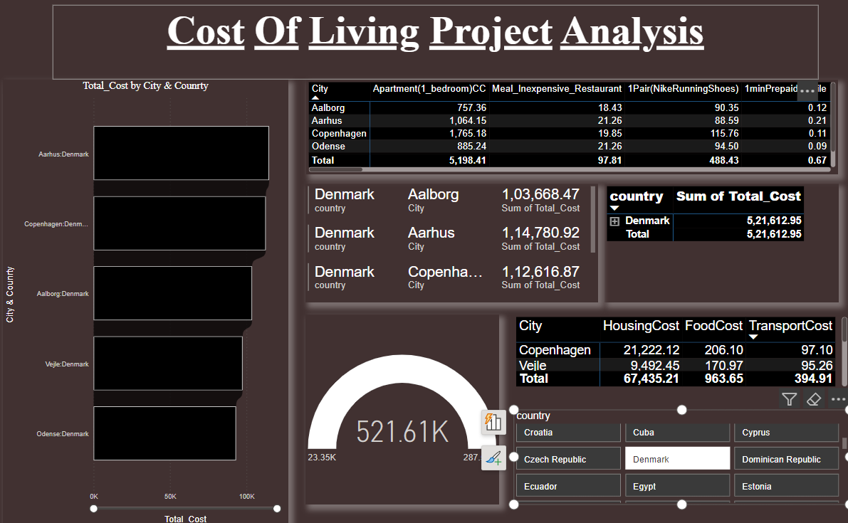
6. Cost Of Living In Denmark PowerBI Visualization.

Slide 14
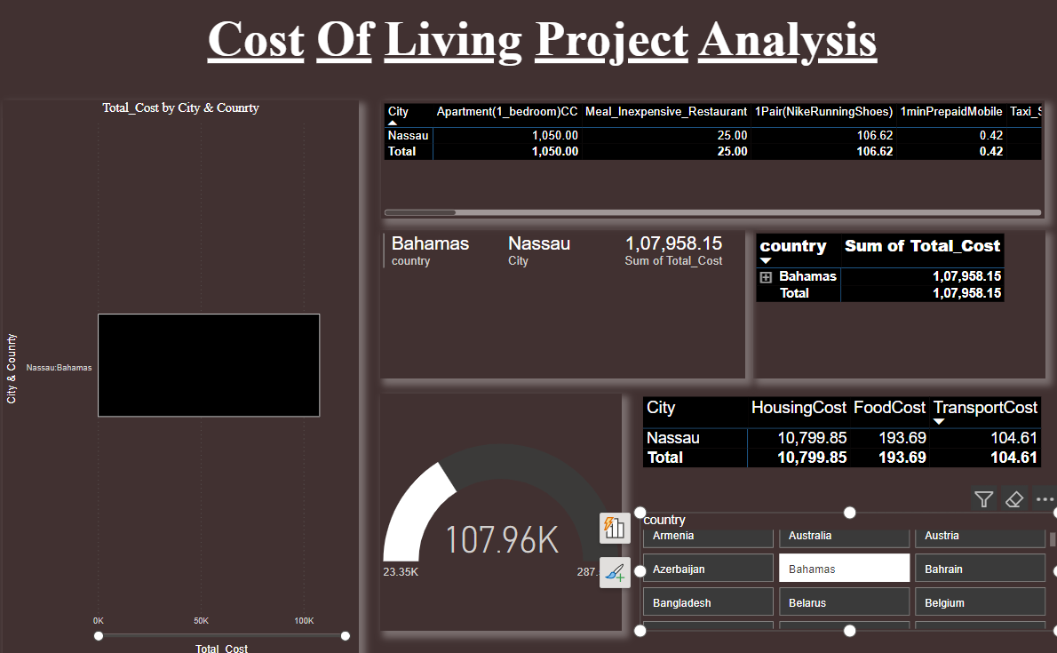
7. Cost Of Living In Bahamas PowerBI Visualization.

Slide 15
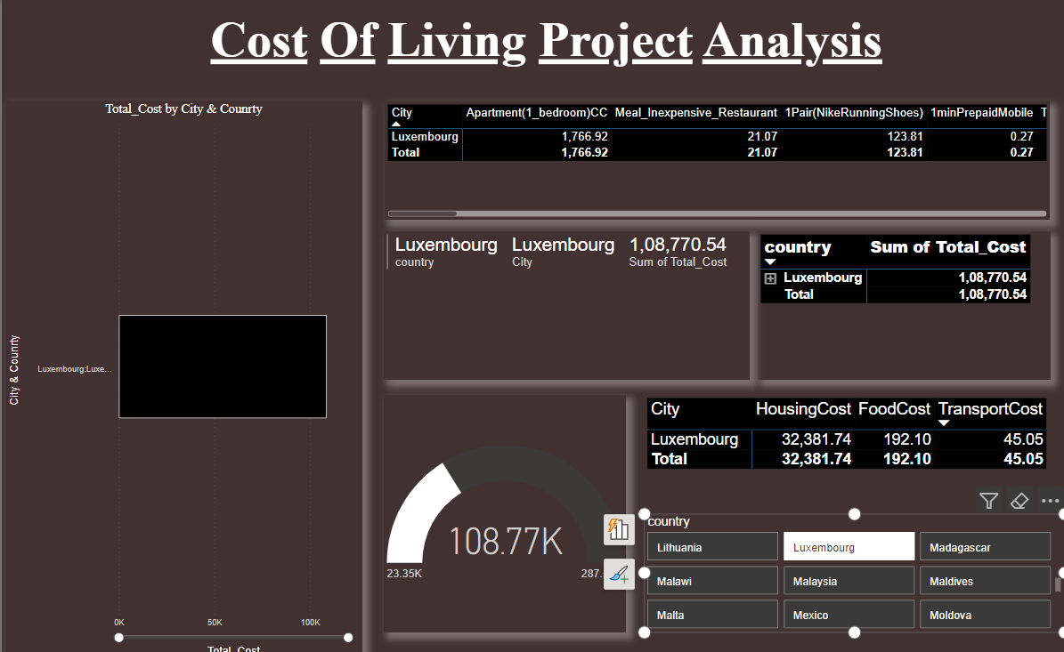
8. Cost Of Living In Luxembourg PowerBI Visualization.

Slide 16
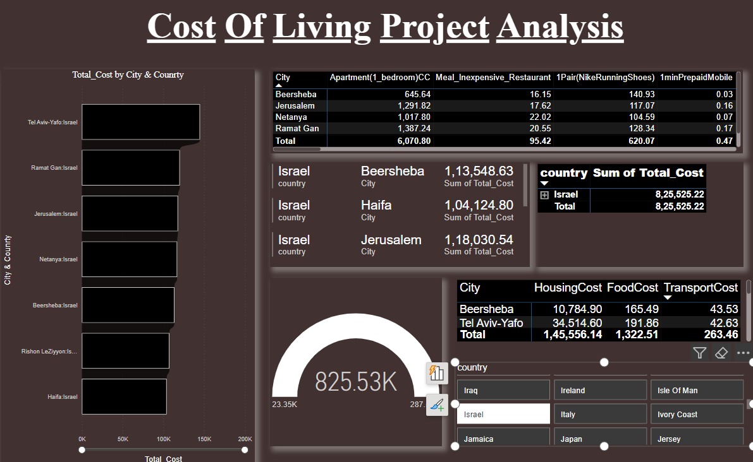
9. Cost Of Living In Israel PowerBI Visualization.

Slide 17
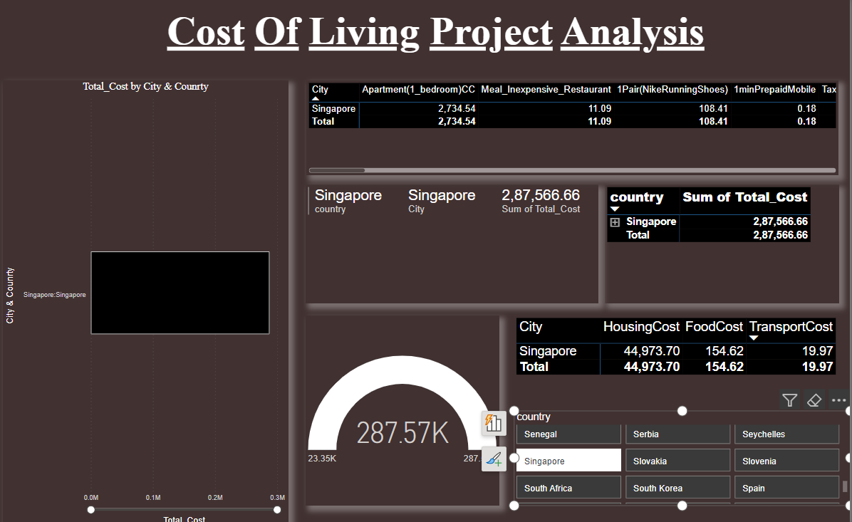
10. Cost Of Living In Singapore PowerBI Visualization.

Slide 18
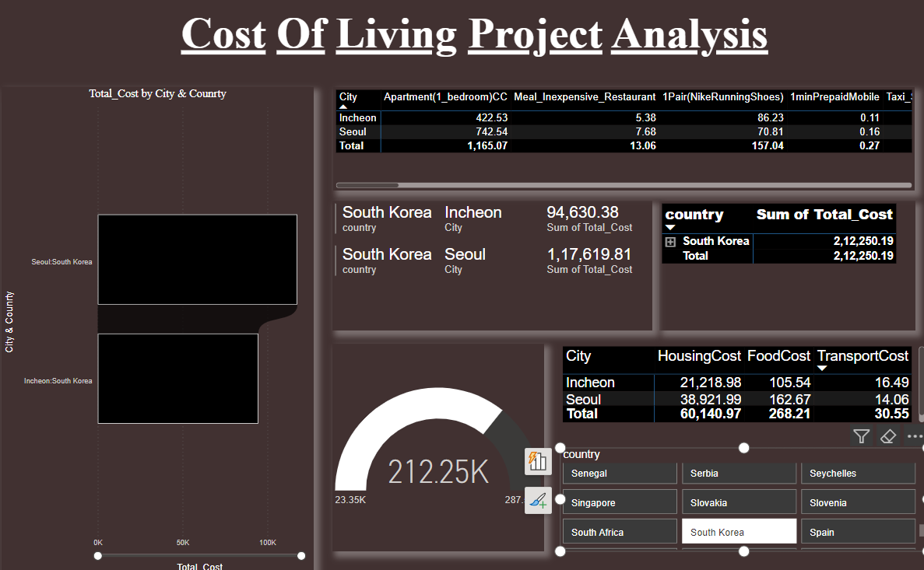
11. Cost Of Living In South Korea PowerBI Visualization.

Slide 19
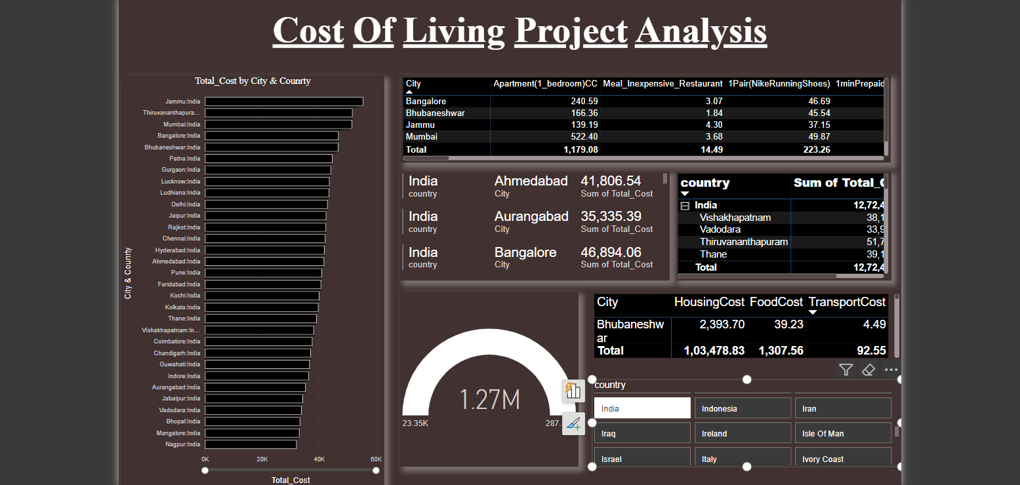
1. Cost Of Living In India PowerBI Visualization.(Bottom)

Slide 20
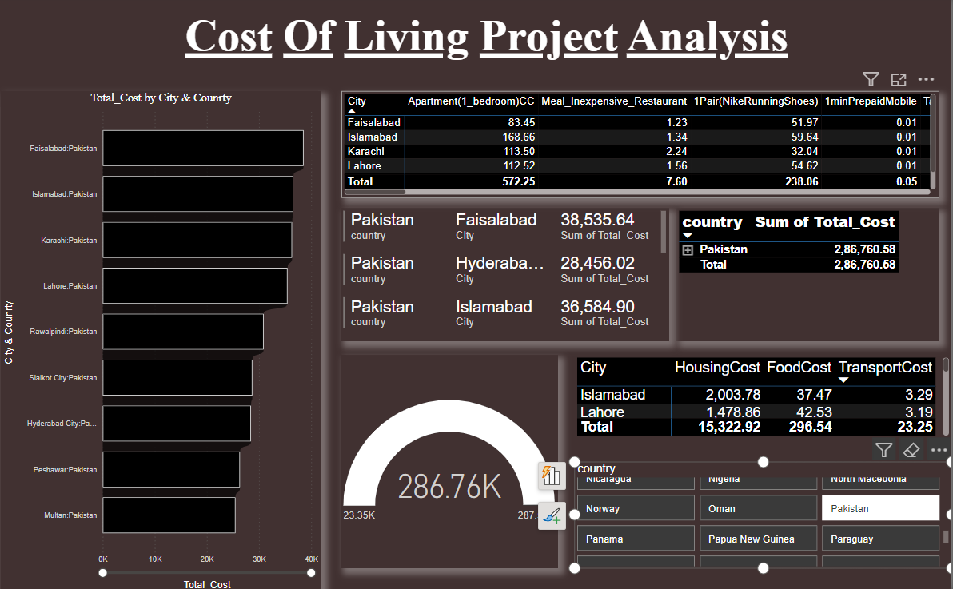
2. Cost Of Living In Pakistan PowerBI Visualization.(Bottom)

Slide 21

Results and Analysis:
The findings of the analysis are presented, including visualizations and key insights derived from the data. Trends, patterns, and correlations discovered through PowerBI Visuals are discussed in detail. The analysis of the Cost of Living dataset reveals significant variations in expenses across different locations, including housing, groceries, transportation, healthcare, and utilities. These findings empower individuals to make informed decisions about where to live based on their budgetary constraints. Moreover, businesses can adjust compensation packages and strategic plans accordingly, while policymakers can use this data to address affordability issues and promote economic development in specific regions. Overall, the dataset's results underscore the importance of understanding regional differences in living costs for effective financial planning and policy-making.

Slide 22
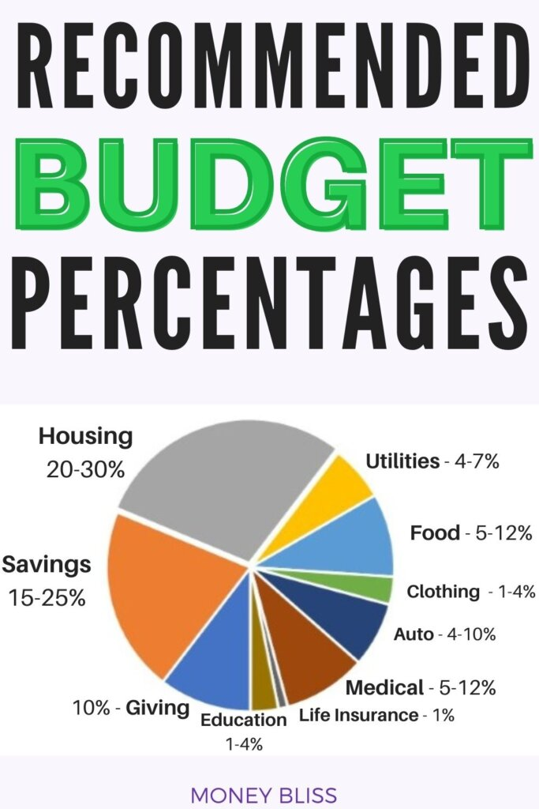
CONCLUSION:
The project concludes with a summary of the main findings and their implications for the Cost of Living dataset provides essential insights into the varying expenses associated with maintaining a standard lifestyle across different locations. Its results highlight significant differences in costs related to housing, groceries, transportation, healthcare, and utilities. This data empowers individuals to make informed decisions about where to live, helps businesses tailor compensation packages and expansion plans, and informs policymakers about regional affordability challenges. Overall, it serves as a crucial tool for financial planning, economic mobility, and promoting equitable access to resources.

Slide 23


